Slide 1

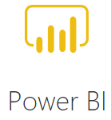

Power BI and R

Slide 2
What is R?
R is a programming language and free software environment for statistical computing and graphics supported by the R Foundation for Statistical Computing.
The R language is widely used among statisticians and data miners for developing statistical software and data analysis.
Polls, data mining surveys, and studies of scholarly literature databases show substantial increases in popularity in recent years. As of January 2019, R ranks 12th in the TIOBE index, a measure of popularity of programming languages.

Slide 3
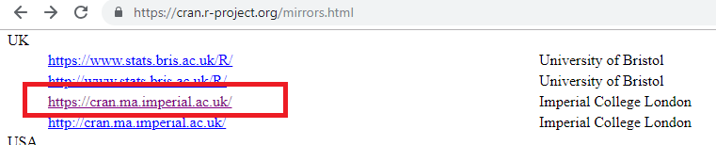
Getting Started with R
Let’s install R and R Studio
Go to https://www.r-project.org/
Pick a mirror to download from. (Pick a UK location)

Slide 4
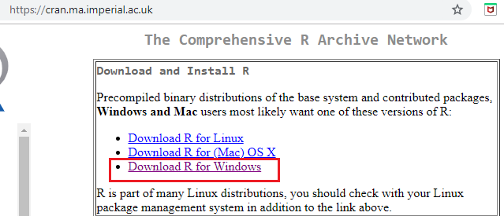
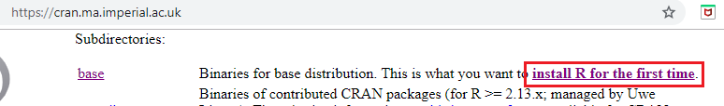
Select the version for your operating system
Select Base Binaries for first installation

Slide 5
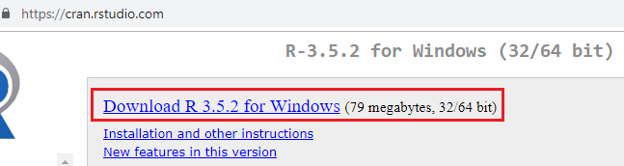
Download and run executable when file is ready.
Now let’s install RStudio (an IDE for R)
Go to https://www.rstudio.com/
Follow instructions for R Studio download
Choose RStudio Desktop Open Source License

Slide 6
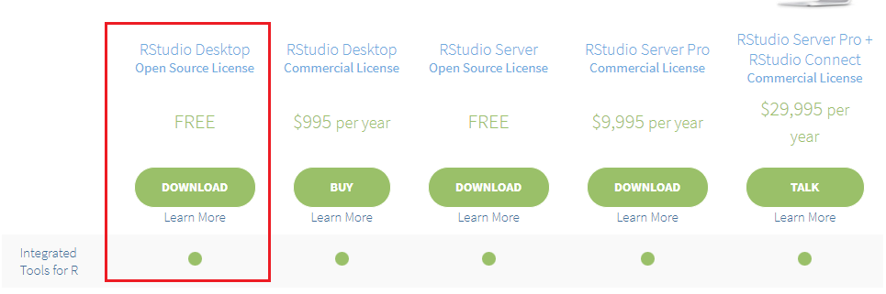
Download Rstudio exe and follow defaults when installing

Slide 7
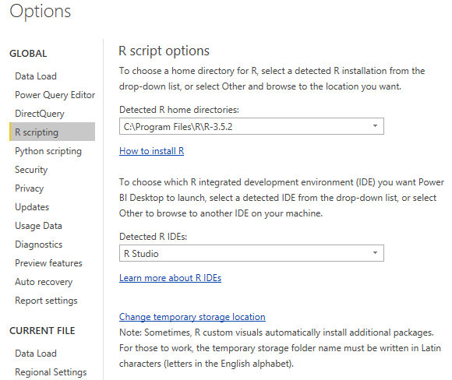
How to set up Power BI to use R
Open Power BI Desktop
Power BI should recognise that you have installed R and RStudio

Slide 8
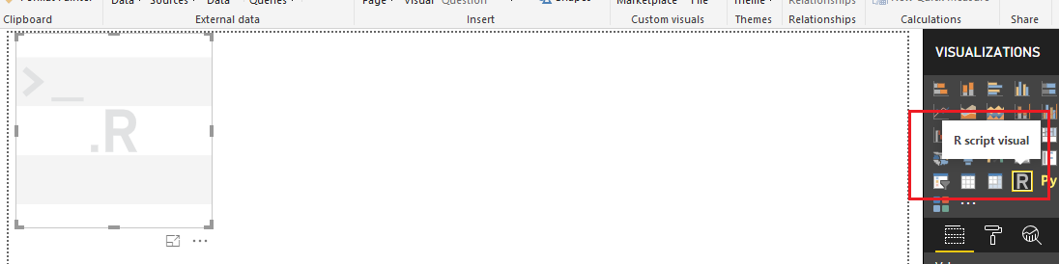
To put a R powered visual into your report, select the R icon as shown

